Slide 1
K-Means Clustering Algorithm
By Dr. Ali Saeed

Slide 2
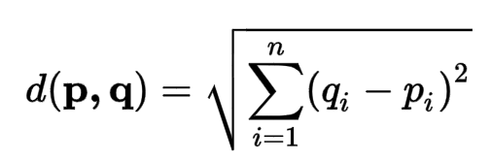
K-Means
It is a clustering algorithm of machine learning that is use to logically group the data items
It works on the concept of “Euclidean Distance”

Slide 3
K-Means
Initially, we need to decide how many clusters we need
Let we need to divide into two classes (we need to centroid)
Instance No | Height | Weight
1 | 185 | 72
2 | 170 | 56
3 | 168 | 60
4 | 179 | 68
5 | 182 | 72
6 | 188 | 77

Slide 4
K-Means
We can randomly select any Centroid.
Let (185, 72) is first centroid
(170, 56) is second centroid
Then we see remining 4 rows belongs to which cluster
For the third row we compute “Euclidean Distance” with row 1 and row 2
Answers: 20.80 and 4.48
Row 3 will join 2nd centroid cluster as it has minimum Euclidean Distance

Slide 5
K-Means
After a row join some group we will again compute new centroid
We will only update the centroid of K2 (as it receive a new instance), but K1 will remain same
New centroid = Old Centroid + New Centroid /2
Here Centroid d 1 will remain same
Centroid 2= (170+168/ 2 , 60+56 /2) ➔ (169, 58)
K1 = 185, 72
K2 = 169, 58

Slide 6
K-Means (Final Answer)
Centroid update formula
K1= {1,4,5,6}
K2 = {2,3}

Slide 7
Thanks

